Slide 1
ACCT2700 Foundations of Accounting & Valuation
Using Excel Goal Seek
Available only on Desktop Excel

Slide 2
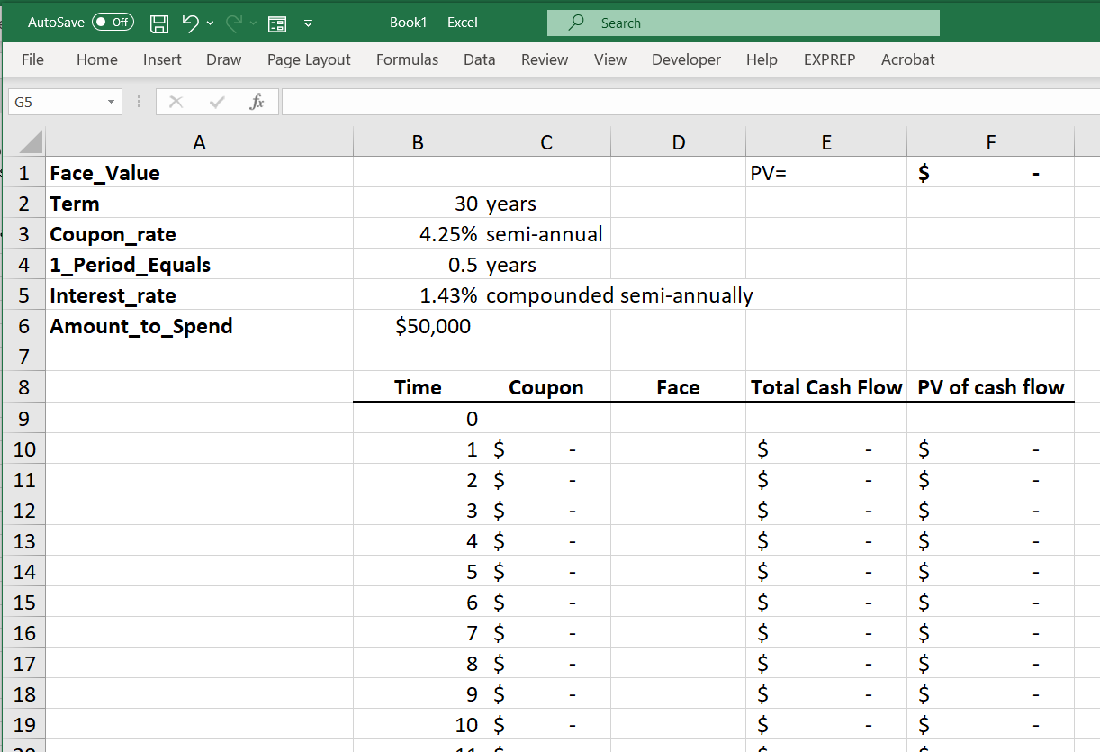
F1 holds the
Present Value
of the bond’s
cash flows.
The cash flows
Are determined
By the:
Face Value
Coupon Rate

Slide 3
The cash flows
Are determined
By the:
Face Value (B1)
Coupon Rate

Slide 4
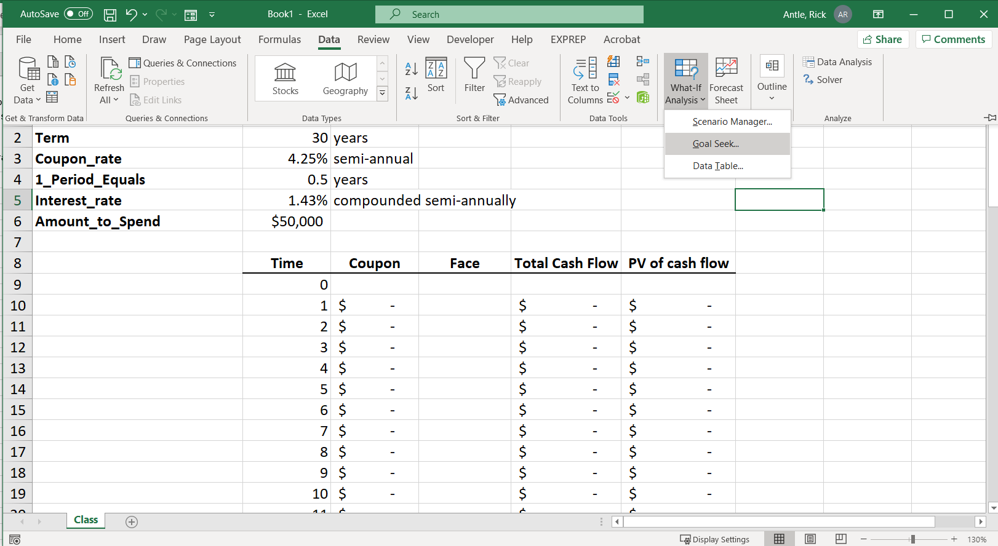
Select:
Data
What If Analysis
Goal Seek

Slide 5
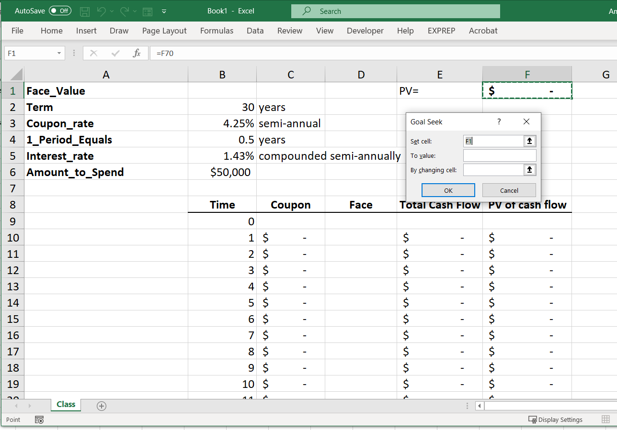

Slide 6
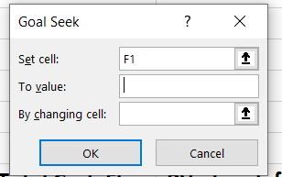
Set cell: F1
F1 contains the
formula for the PV
of the bond’s cash
flows. Excel’s goal
is to make this cell
a certain value.

Slide 7
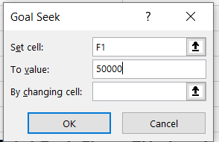
We want the value
In F1 to be 50000.
I.e., we want the
Present value of the
Bond’s cash flows (which
is the value of the bond)
to be $50,000.

Slide 8
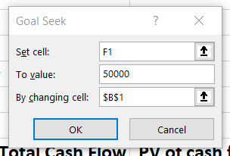
Excel is to get F1 to equal
50,000 by changing cell B1
Recall B1 is the Face
Value of the bonds.

Slide 9
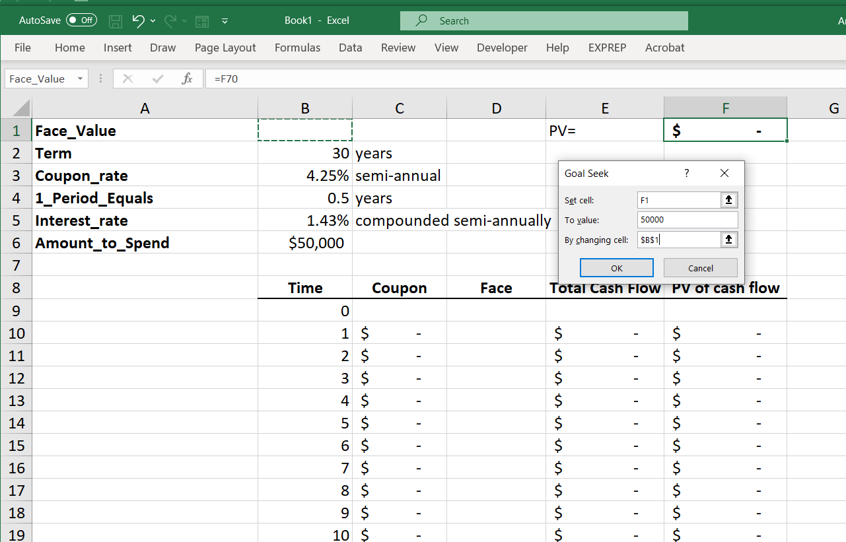
Hit OK

Slide 10
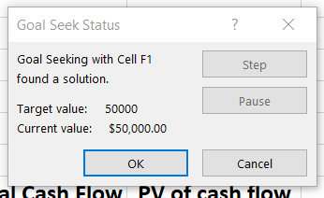
It found a solution (that doesn’t always happen) and it achieved the desired value of $50,000.
Hit OK

Slide 11
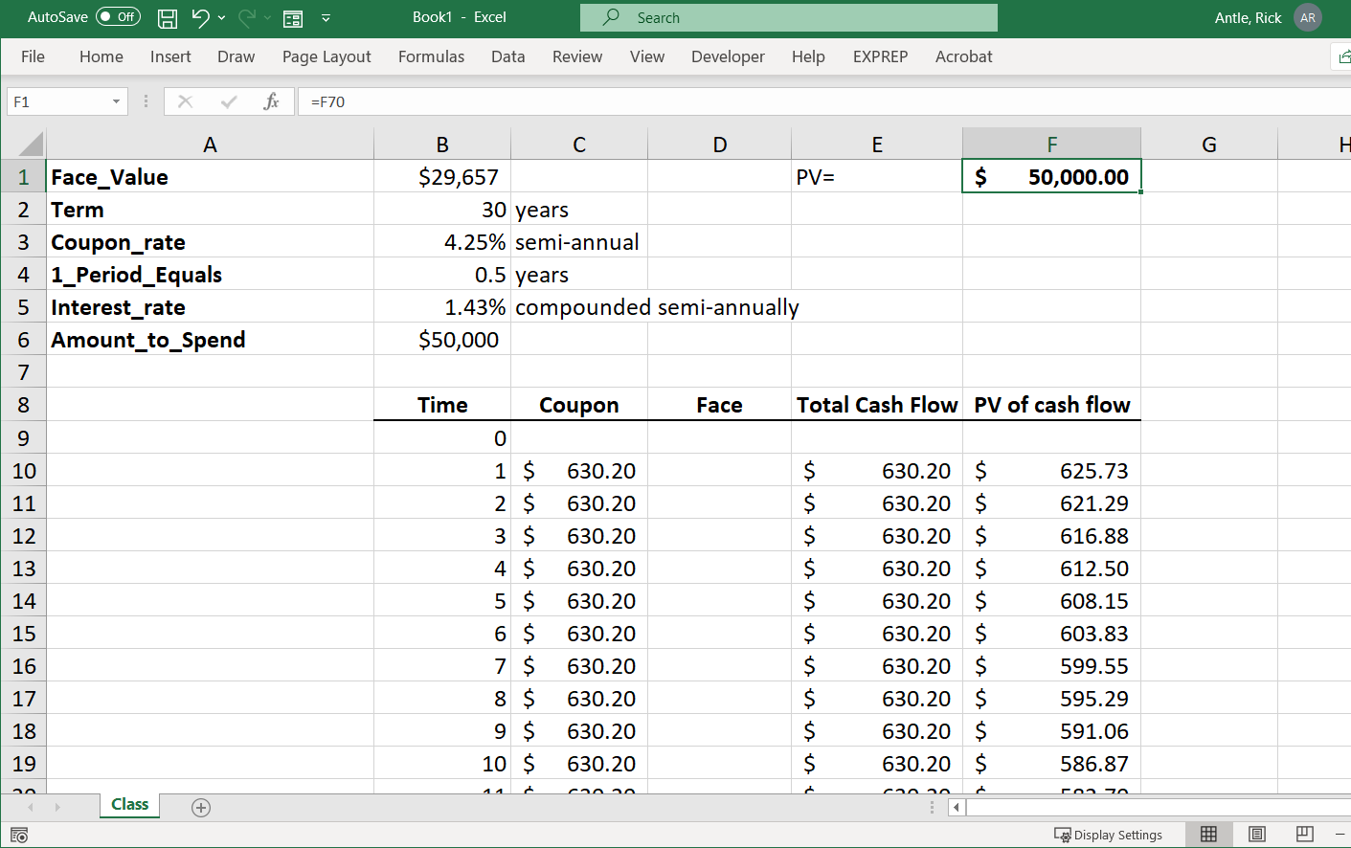
Bonds with a face value of $29,657 that have a coupon of 4.25% paid semi-annually over a 30-year life have a present value of $50,000 when the interest rate is 1.43% compounded semi-annually.

Slide 12
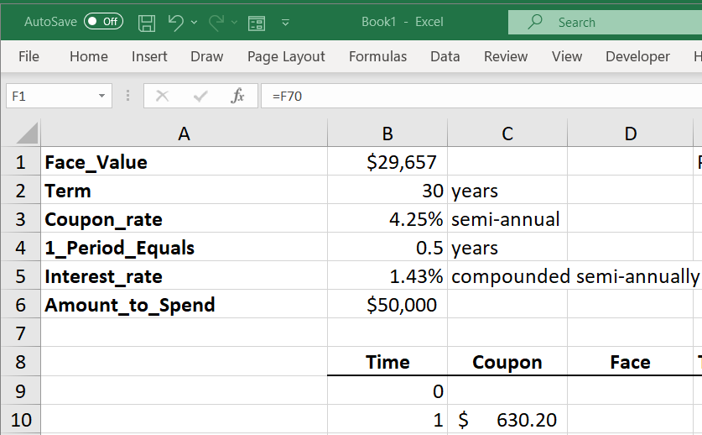
Close-up of the bond
Terms that generate
A present value of
$50.000.

